Slide 1
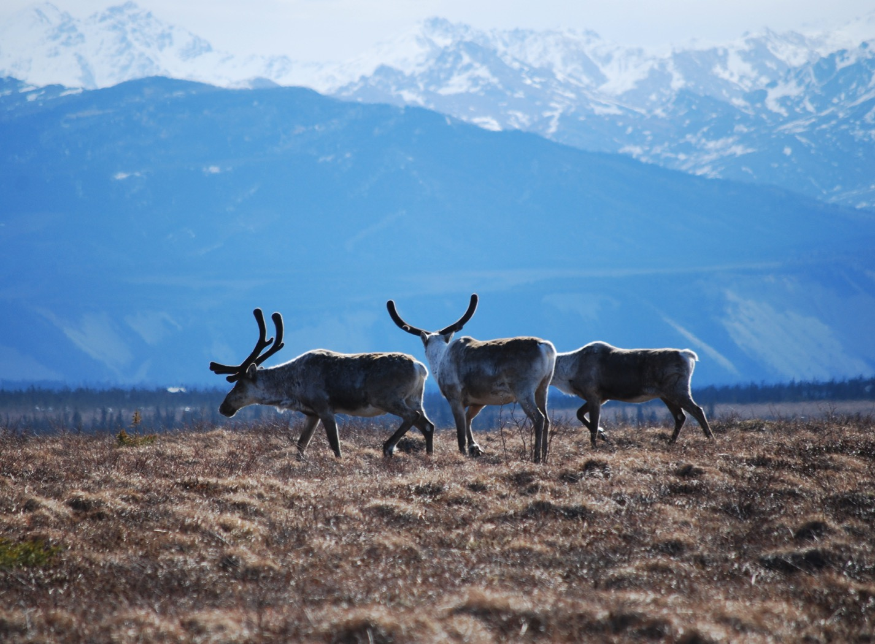
Arctic Boreal Vulnerability Experiment (ABoVE)
2017 ABoVE Airborne Campaign
17 July 2017 (DOY 198)
AirSWOT/Ka-SPAR:
Inuvik – Old Crow Flats – Yukon Flats – Fairbanks
Charles Miller, Deputy Science Lead
Jet Propulsion Laboratory, California Institute of Technology
and the ABoVE Science Team For Hank Margolis, Eric Kasichke, Bruce Tagg
NASA HQ
2017

Slide 2
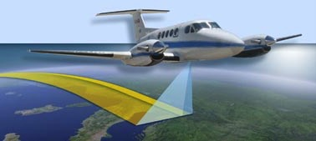
17 July 2017/DOY 198 Inuvik – Old Crow – Yukon Flats - PAFA
Daily Status:
N801NA AirSWOT ABoVE CAMPAIGN (CANADA / ALASKA)
REPORT DATE: 17 July 2017
Current Status of Aircraft: GREEN
Current Status of Radar: Yellow Failed receiver (socket 5)
Current Status of Camera: Yellow Replacement camera
Current Status of Crew: GREEN
Current Deployment Location: Fairbanks International Airport (PAFA)
Crew: Salling, Posada, Chao, Soto
Science Coordinators: T Pavelsky, C Rains
Science Lead: L Smith
Project Manager: Y Lou

Slide 3
17 July 2017/DOY 198 Inuvik – Old Crow – Yukon Flats - PAFA
Daily Summary:
Transit/Science Flight – Inuvik (CYEZ) to Fairbanks (PAFA) – 3.6 hours
AirSWOT team successfully flew the PAVE_0068 this morning and landed at Fairbanks, AK.
Science lines in Canada/Alaska
Collected 9 of 9 data lines
Both radar instrument and IR camera performed nominally
369 pictures recorded
Tues 7/18: Hard down day

Slide 4
17 July 2017/DOY 198 72-Hour Look Ahead
All plans weather dependent
Tuesday 18 July 2017 (DOY 199):
Hard down day
Wednesday 19 July 2017 (DOY 200):
Field team targeting joint ground-airborne acquisitions along Sagawon River (North Slope)
Thursday 20 July 2017 (DOY 201):
TBD
Friday 21 July 2017 (DOY 202):
Backup day for joint ground-airborne acquisitions along Sagawon River (North Slope)

Slide 5
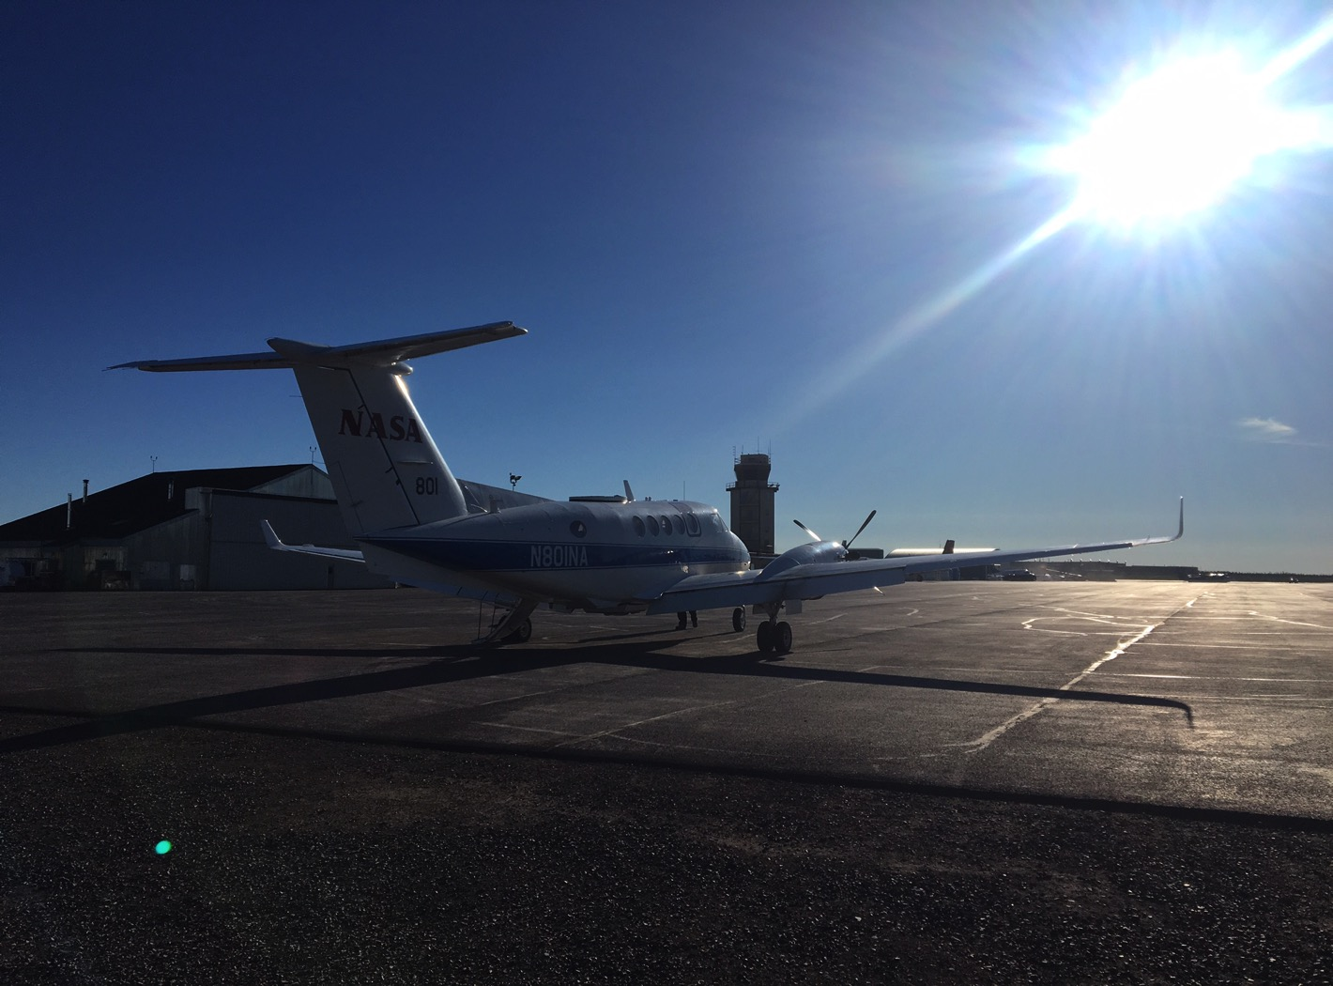
17 July 2017/DOY 198 72-Hour Look Ahead
Ka-SPAR / NASA 801 prepares to depart from Inuvik NT

Slide 6
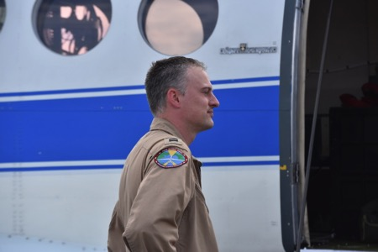
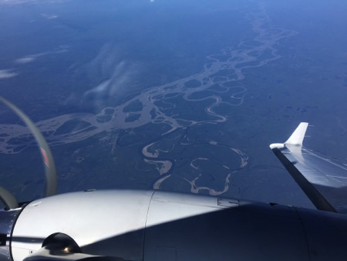
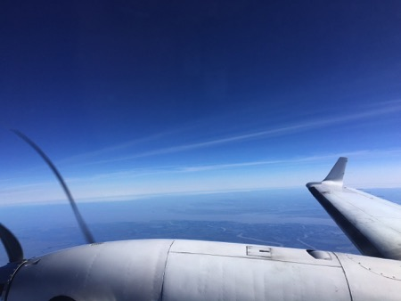
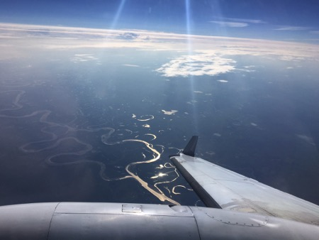
17 July 2017/DOY 198 Inuvik – Old Crow – Yukon Flats - PAFA

Slide 7
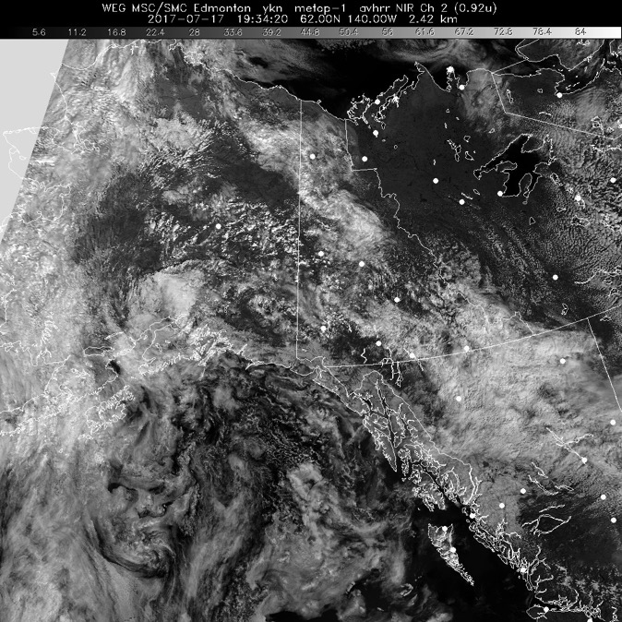
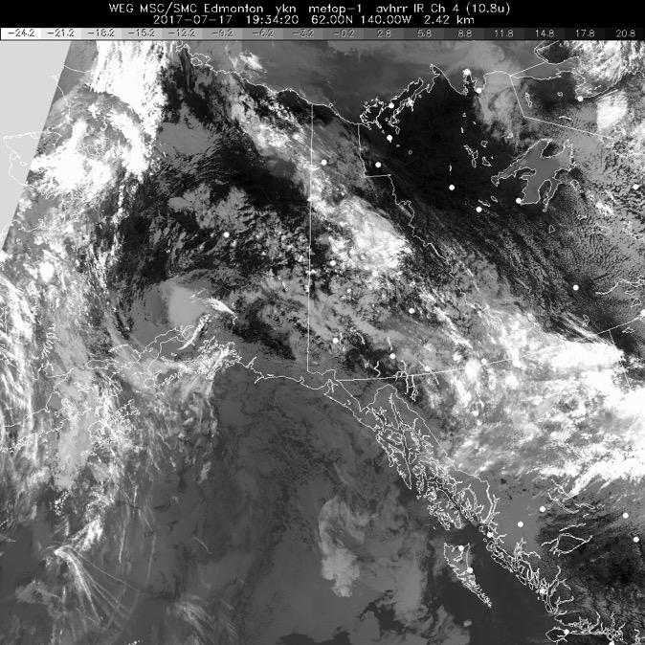
17 July 2017/DOY 198 Inuvik – Old Crow – Yukon Flats - PAFA
HRPT Visible
1934Z
HRPT IR
1934Z
Clear to partly cloudy over the Inuvik – Old Crow Flats – Yukon Flats region

Slide 8
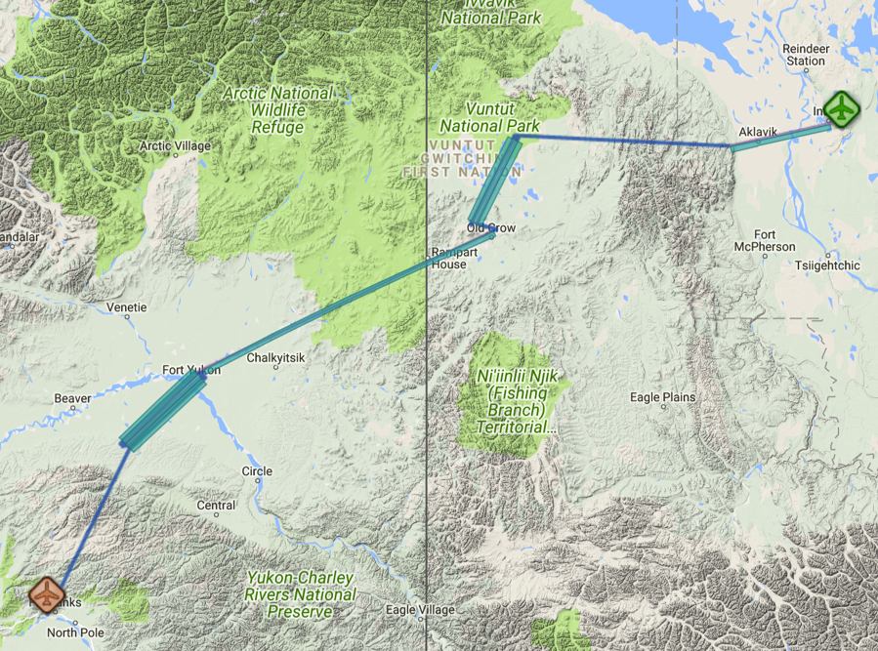
17 July 2017/DOY 198 Inuvik – Old Crow – Yukon Flats - PAFA
Flight Plan Report: pavelky_0068 (Inuvik Fairbanks May 31)
https://flightplanning.jpl.nasa.gov/cgi-bin/report.pl?planID=pavelky_0068#summary
Data Acquisitions:
Line 1 pave02_271aa
Line 2 pave06_207aa
Line 3 pave06_027aa
Line 4 pave06_206aa
Line 5 pave02_244aa
Line 6 pave03_227aa
Line 7 pave03_047aa
Line 8 pave05_227aa
Line 9 pave04_047aa
Line 10 pave04_227aa
Line 1 acquired on 7/16/17
pave02_271aa
pave06_207aa
pave06_027aa
pave06_206aa
pave02_244aa
pave03_227aa
pave03_047aa
pave05_227aa
pave04_047aa
pave04_227aa
Flight plan & acquisition segments

Slide 9
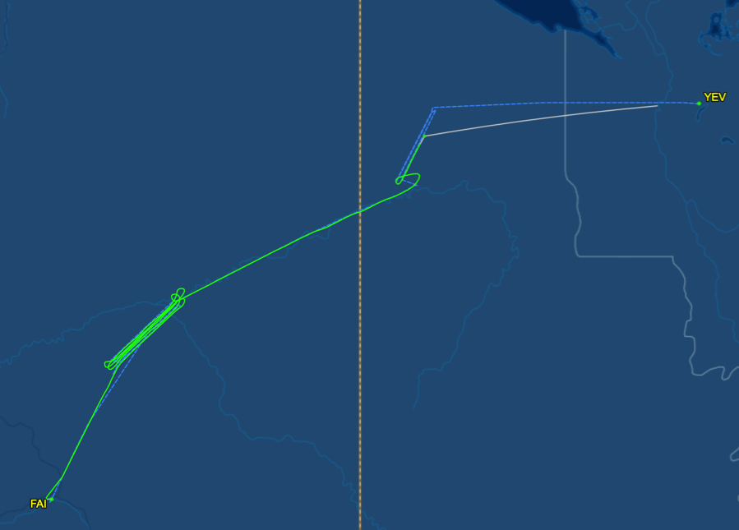
17 July 2017/DOY 198 Inuvik – Old Crow – Yukon Flats - PAFA
Flight Plan Report: pavelky_0068 (Inuvik Fairbanks May 31)
https://flightplanning.jpl.nasa.gov/cgi-bin/report.pl?planID=pavelky_0068#summary
Data Acquisitions:
Line 1 pave02_271aa
Line 2 pave06_207aa
Line 3 pave06_027aa
Line 4 pave06_206aa
Line 5 pave02_244aa
Line 6 pave03_227aa
Line 7 pave03_047aa
Line 8 pave05_227aa
Line 9 pave04_047aa
Line 10 pave04_227aa
Line 1 acquired on 7/16/17
As-flown lines & acquisition segments
pave06_207aa
pave06_027aa
pave06_206aa
pave02_244aa
pave03_227aa
pave03_047aa
pave05_227aa
pave04_047aa
pave04_227aa
Inuvik NT (CYEV) to
Fairbanks AK (PAFA)

Slide 10
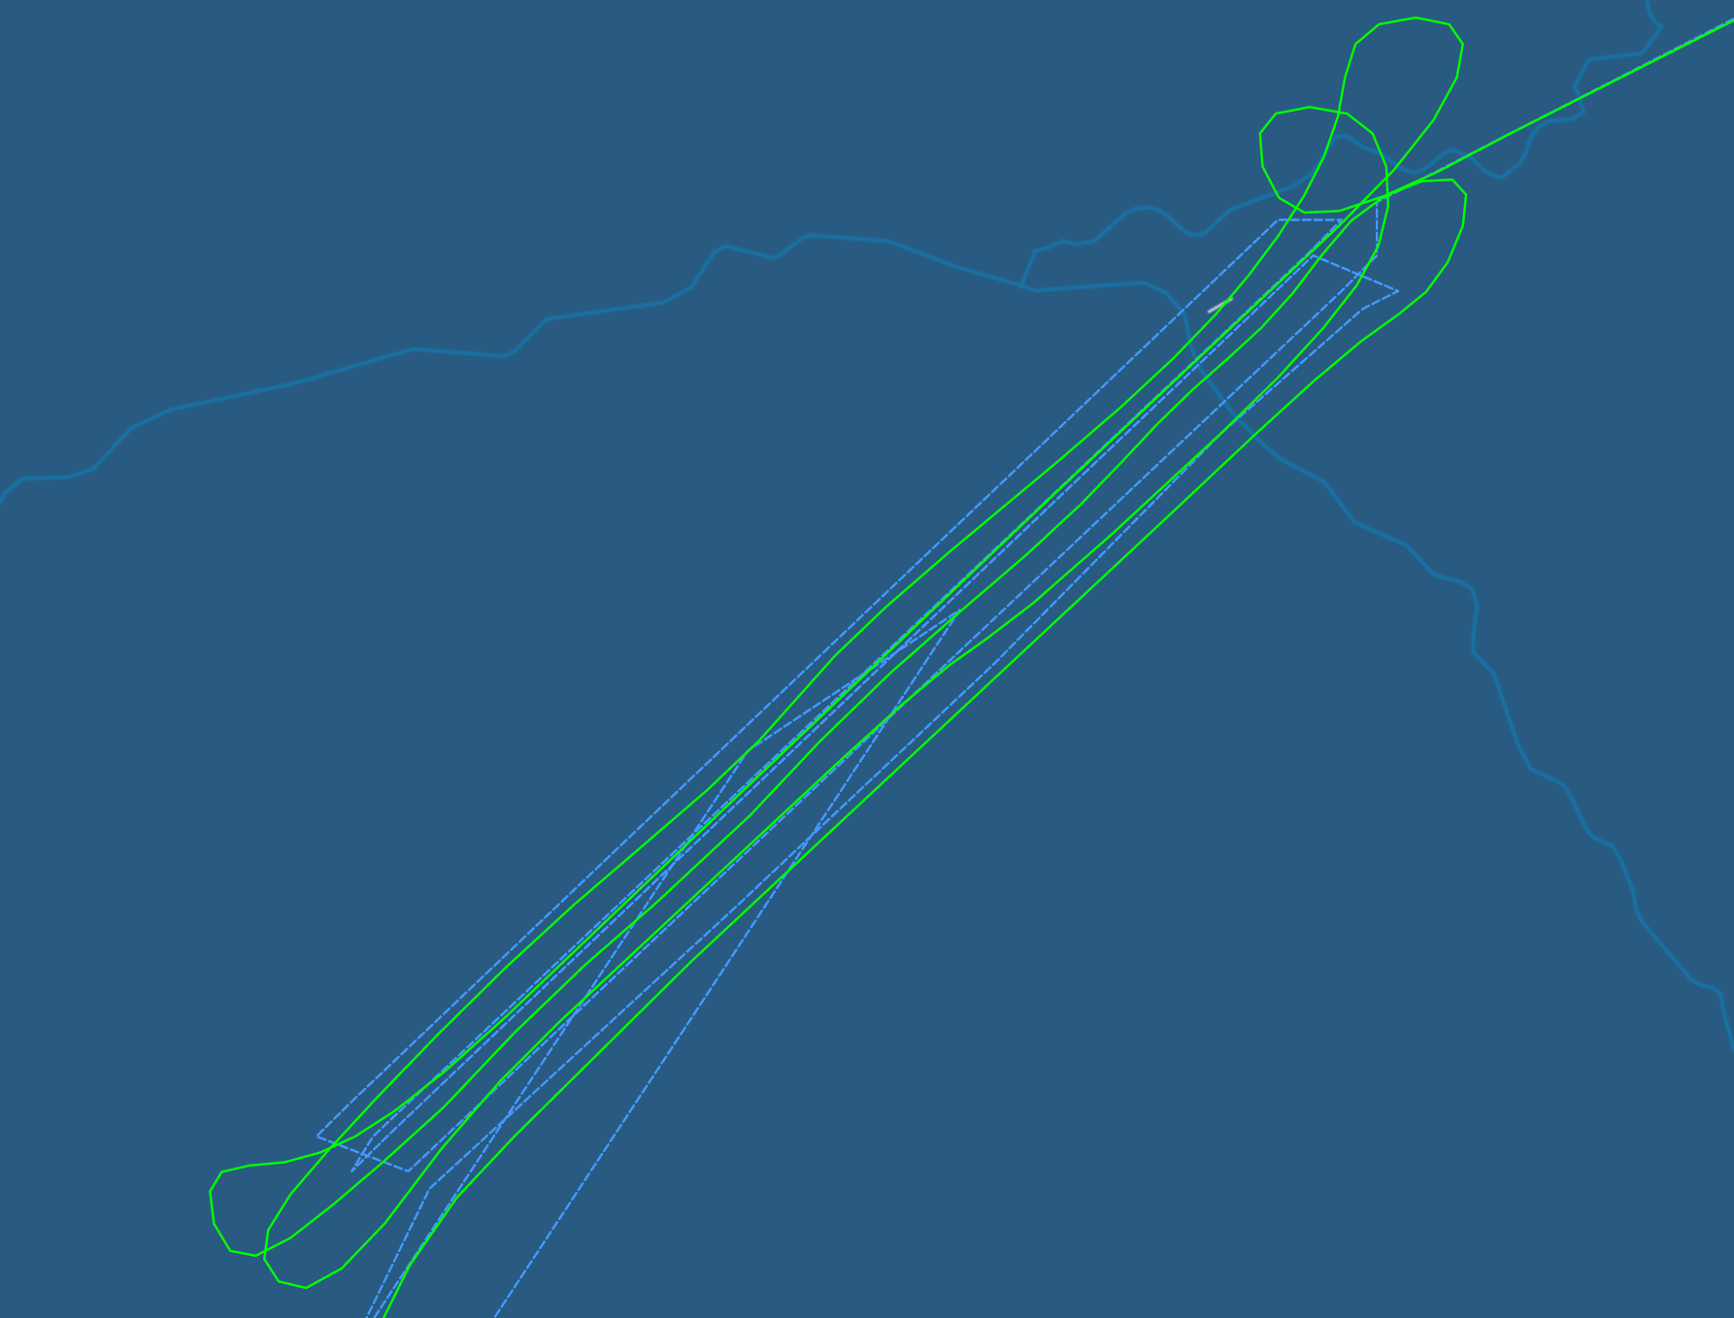
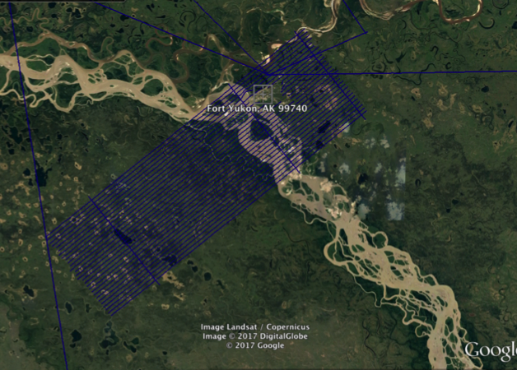
17 July 2017/DOY 198 Inuvik – Old Crow – Yukon Flats - PAFA
Ka-SPAR Yukon Flats Intensive Sampling Area
As-flown lines & acquisition segments
pave03_227aa
pave03_047aa
pave05_227aa
pave04_047aa
pave04_227aa
pave01_040aa
pave01_040aa
USGS Fort Yukon EMI Sampling
pave01_040aa
pave10_307aa
Notes:
Five (5) lines flown over Fort Yukon, repeating sampling performed in 2015. These lines also covers a transect flown by USGS with electromagnetic imaging (EMI) [Minsley, B. J., et al. (2012), Airborne electromagnetic imaging of discontinuous permafrost, Geophys. Res. Lett., 39, L02503, doi:10.1029/2011GL050079]

Slide 11
17 July 2017/DOY 198 Inuvik – Old Crow – Yukon Flats - PAFA
Quick-look products to be generated

